Slide 1
SQL Capstone project
Prepared by: Erowo faith Igbikidima
Course:SQL for data Analytics
Tools used : PostgreSQL, SQL and google doc
Submission date: 01:00 PM (GMT+1) on Saturday, 27 June 2026
Facilitator: Gideon Ezimechina

Slide 2
TABLE OF CONTENTS
1. Executive Summary
2. Business Problem
3. Project Objectives
4. Dataset Overview
5. Methodology
6. Business Questions and Analysis
Question A
Question B
Question C
Question D

Slide 3
Question E
Question F
Question G
Question H
Question I
Question J
7. Key Findings
8. Recommendations
9. Conclusion
10. Appendix

Slide 4
⸻
1. EXECUTIVE SUMMARY
Executive Summary
This report analyzes the Education for All fundraising data to provide insights
that support better fundraising decisions. Using PostgreSQL and SQL,
donor and donation data were analyzed to identify donation trends, donor behavior, and key fundraising opportunities.
The findings provide recommendations to help increase the number of donors,
improve donation frequency, and maximize donation value through data-driven strategies.

Slide 5
Business Problem
Education for All is a charity organization that aims to improve its fundraising performance. However, the organization needs a better understanding of donor behavior, donation patterns, and donor characteristics to make informed fundraising decisions. This analysis was conducted to identify key insights from the donation data and provide recommendations that will help increase the number of donors, encourage more frequent donations, and increase the overall value of donations.

Slide 6
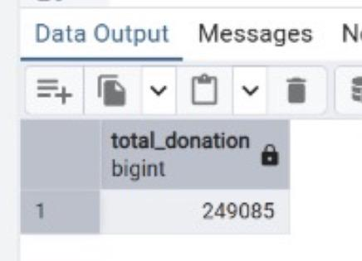
BUSINESS QUESTIONS AND ANALYSIS
Question A
How much is the total donation?
The total donation raised is 249,085, representing the total funds contributed by all donors in the dataset.

Slide 7
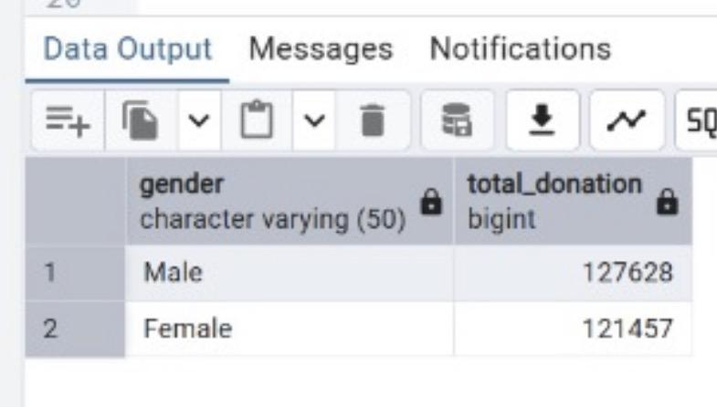
Question B
What is the total donation by gender?
This analysis shows the total donation contributed by each gender, helping to identify which group contributed more to the overall fundraising.

Slide 8
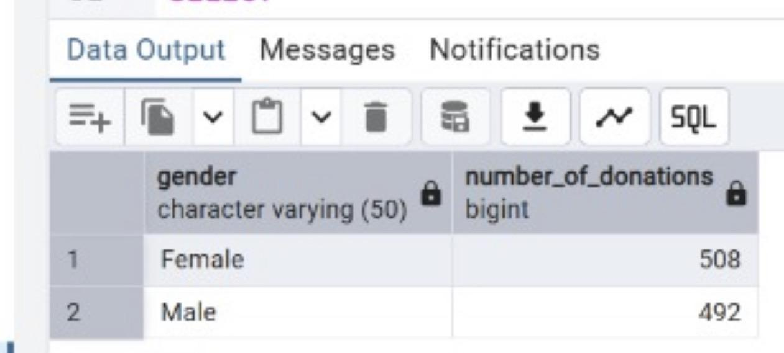
Question C
Show the total donation and number of donations by gender.
This analysis compares the total donation amount and the number of donations made by each gender, helping to identify differences in donation behavior. The results show that male donors contributed a higher total donation ($127,628) despite making fewer donations (492) than female donors, who made 508 donations totaling $121,457. This suggests that, on average, male donors gave larger donation amounts.

Slide 9
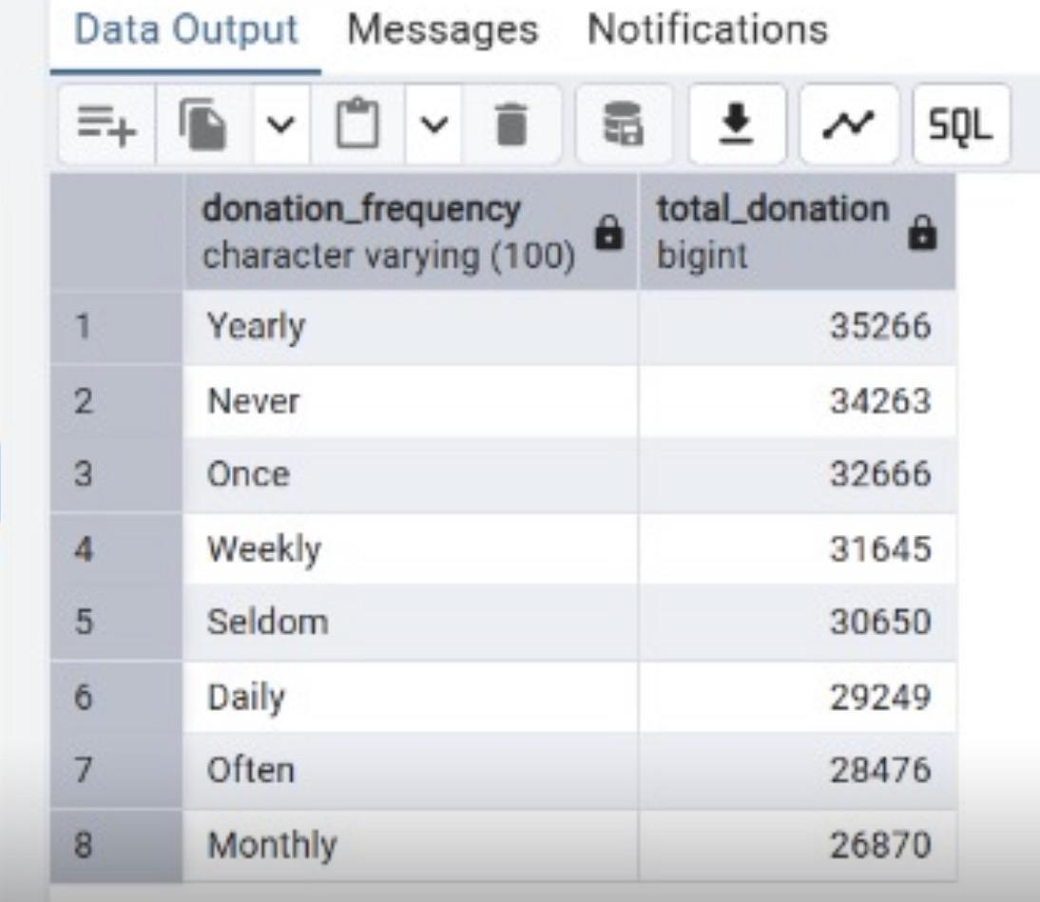
Question D
Total donation made by frequency of donation.
This analysis shows the total donation amount by donation frequency. Yearly donors contributed the highest total donation ($35,266), while Monthly donors contributed the least ($26,870). It is worth noting that the “Never” category also recorded donations, which suggests a possible inconsistency in the dataset or how donation frequency was recorded.

Slide 10
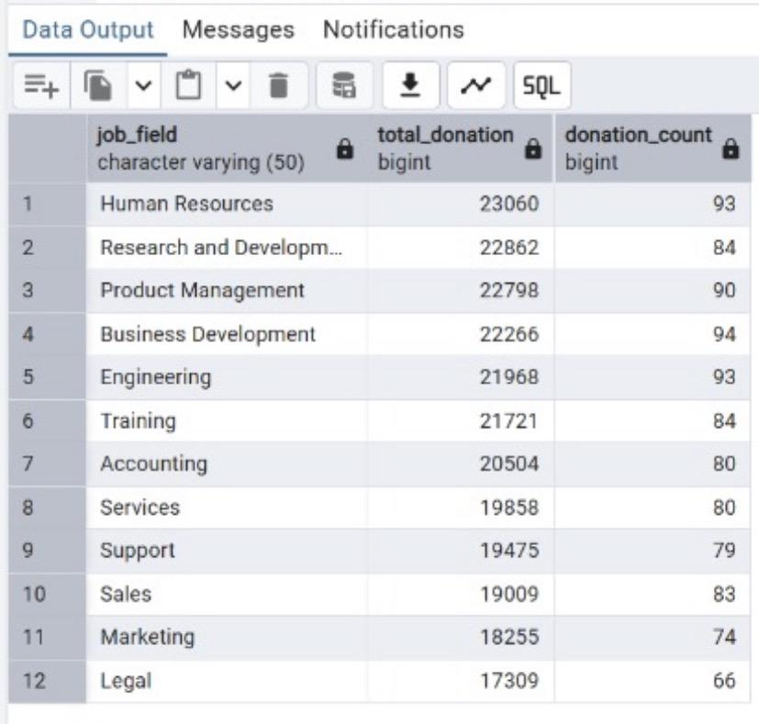
Question E
Total donation and number of donations by job field.
:
This analysis shows the total donation amount and the number of donations by job field, helping identify the occupations that contribute the most to fundraising.

Slide 11
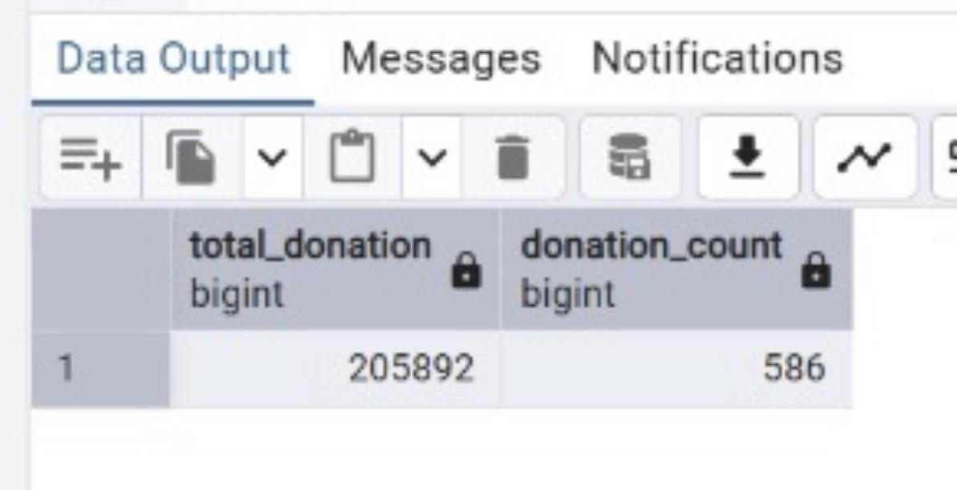
Question F
Total donation and number of donations above $200.
This analysis shows the total donation amount and the number of donations above $200. A total of 586 donations above $200 contributed $205,892, indicating that high-value donations make a significant contribution to the organization’s total fundraising.

Slide 12
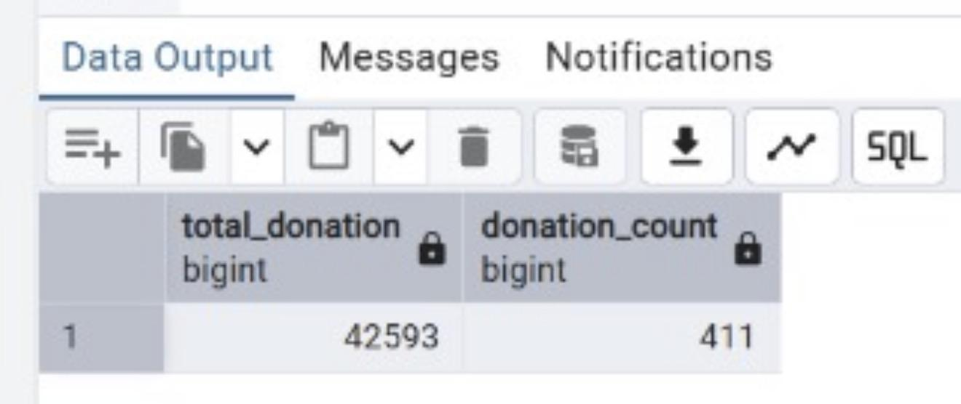
Question G
Total donation and number of donations below $200.
This analysis shows the total donation amount and the number of donations above $200. The results indicate that 586 donations above $200 generated a total of 205,892, showing that high-value donations make a significant contribution to the organization’s fundraising.

Slide 13
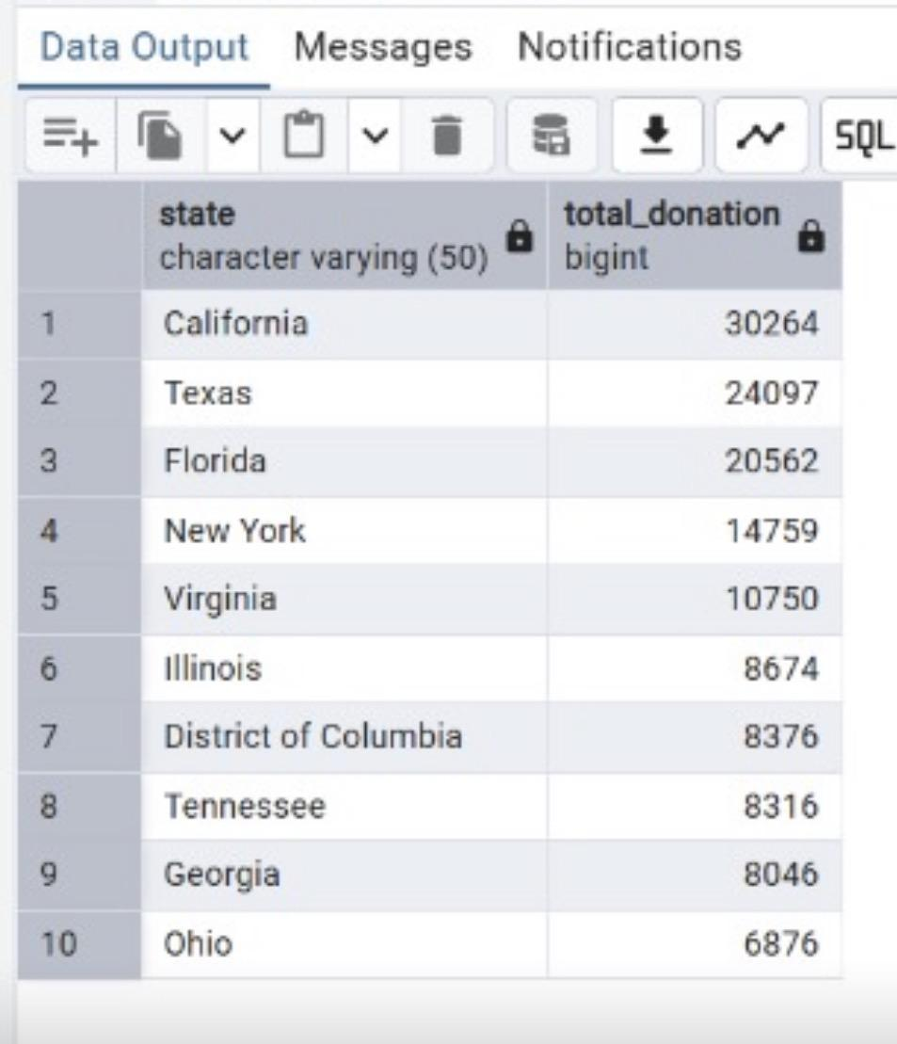
Question H
Top 10 states contributing the highest donations.
This analysis identifies the top 10 states with the highest total donations, helping the organization identify its strongest fundraising regions. California recorded the highest total donation ($30,264), followed by Texas ($24,097) and Florida ($20,562), while Ohio ranked tenth with $6,876. These states represent key areas for maintaining and expanding fundraising efforts.

Slide 14
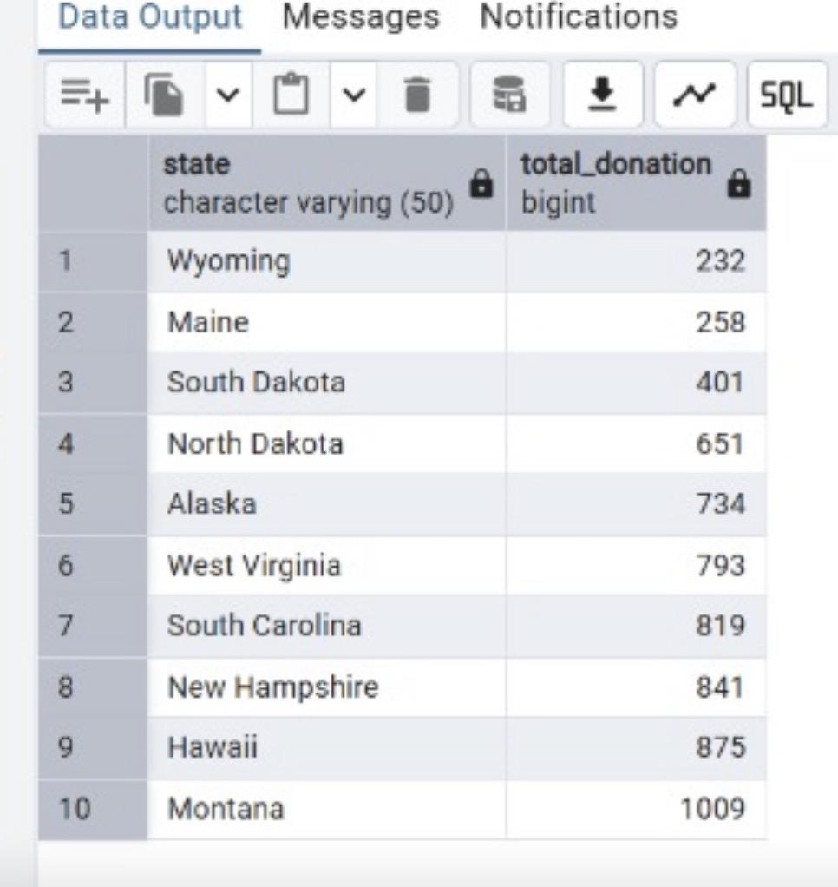
Question I
Top 10 states contributing the least donations.
This analysis identifies the top 10 states with the lowest total donations, helping the organization recognize regions with lower fundraising performance. Wyoming recorded the lowest total donation (232), while Montana ranked tenth with 1,009. These states present opportunities for targeted fundraising campaigns and improved donor engagement.

Slide 15
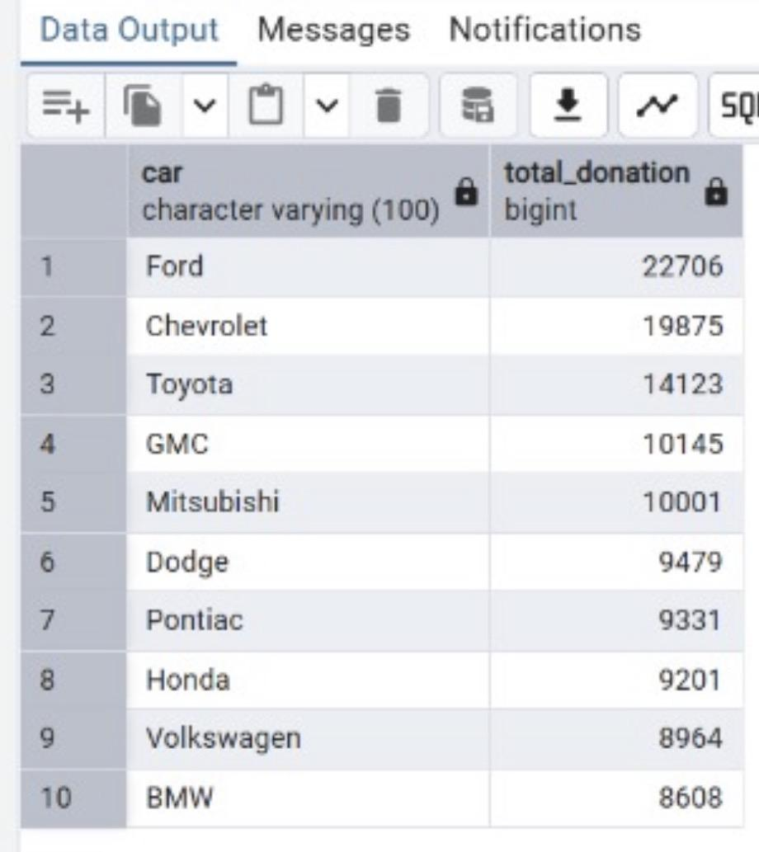
Question J
Top 10 cars driven by the highest donors.
This analysis identifies the top 10 car brands driven by the highest donors, providing insight into donor characteristics. Ford owners contributed the highest total donation ($22,706), followed by Chevrolet ($19,875) and Toyota ($14,123), while BMW ranked tenth with $8,608.

Slide 16
Dataset
This analysis was conducted using two datasets provided by Education for All:
Donation_Data: Contains donor information such as donor ID, name, gender, job field, donation amount, state of residence, and shirt size.
Donor_Data: Contains additional donor information including donation frequency, university attended, car make, second language, favourite colour, and movie genre.
The two datasets were linked using the Donor ID (id) to enable comprehensive analysis.

Slide 17
Methodology
Imported the Donation_Data and Donor_Data datasets into PostgreSQL.
Joined the two datasets using the JOIN and ON clauses based on the Donor ID (id)
.
Used SQL statements and functions such as SELECT, FROM, WHERE, GROUP BY, ORDER BY, ASC, DESC, LIMIT, COUNT(), and SUM() to answer the required business questions.
Interpreted the query results to generate insights and recommendations for the fundraising strategy.

Slide 18
Keyboard Findings
The total donation received from all donors provides a benchmark for evaluating the organization’s fundraising performance.
Male donors contributed a higher total donation than female donors, despite making fewer donations.
Yearly donors generated the highest total donation, while Monthly donors contributed the least.
The “Never” donation frequency category also recorded donations, suggesting a possible inconsistency in the dataset or how donation frequency was recorded.
Donations above $200 accounted for a significant portion of the total funds raised, contributing 205,892 from 586 donations.
California, Texas, and Florida recorded the highest total donations, while Wyoming, Maine, and South Dakota recorded the lowest.
Donors who drive Ford, Chevrolet, and Toyota contributed the highest total donations among the top 10 car brands.

Slide 19
Recommendations
1. Increase the number of donors
Launch targeted fundraising campaigns in states with lower donation levels.
Use referral programs and social media campaigns to attract new donors.
2. Increase donation frequency
Encourage one-time donors to become recurring donors through monthly or yearly giving programs.
Send regular reminders and personalized messages to keep donors engaged.
3. Increase the value of donations
Recognize and reward high-value donors to encourage continued support.
Develop fundraising campaigns that inspire donors to contribute larger amounts through impact stories and donation incentives.

Slide 20
Conclusion
This analysis provided meaningful insights into donor behavior and fundraising performance using SQL. The findings highlighted key donation trends, donor characteristics, and regional contributions that can support data-driven fundraising decisions. By implementing the recommendations presented, Education for All can strengthen donor engagement, increase donation frequency, and improve overall fundraising outcomes.

